Slide 1

RDBMS and MongoDB for BookMyTickets
Group 21

Slide 2
About BookMyTickets
BookMyTickets is a mobile application where user will log in with the username and password and can select from the various movies running in the multiplex which will show them the number of seats and screen number. After the payment for the ticket, user gets the booking id which will be the confirmation of their ticket booked in the respective auditorium.
There are also options which help the users with nearby restaurants and taxi services. This mobile application will help users to find nearby restaurants where they can go out for dinner and what taxi services will be there in the proximity.

Slide 3
Use Case
Booking a movie on the BookMyticket platform.
User goes on the app and log in with the details of username and password.
App shows different movies on with various locations within the UK.
App also shows how many screens and numbers of seats does that auditorium has.
After making the payment, user is notified with the reservation id which will have information on auditorium id, screen id, seat id, movie id and screen start time.

Slide 4


Polyglot Persistence
BookMyTicket application uses RDBMS and NoSQL databases in designing its data architecture to benefit from a mixture of data sources i.e., SQLite and MongoDB.
The data flow within the application was designed to allow the data to be distributed in the system. The critical tables like User, Reservation, Movie, Seat_reserved, Seat, Auditorium, Screening were designed using relational database i.e. SQLite. The less critical ones such as taxi and restaurants were designed as collection on the document database i.e., MongoDB.

Slide 5
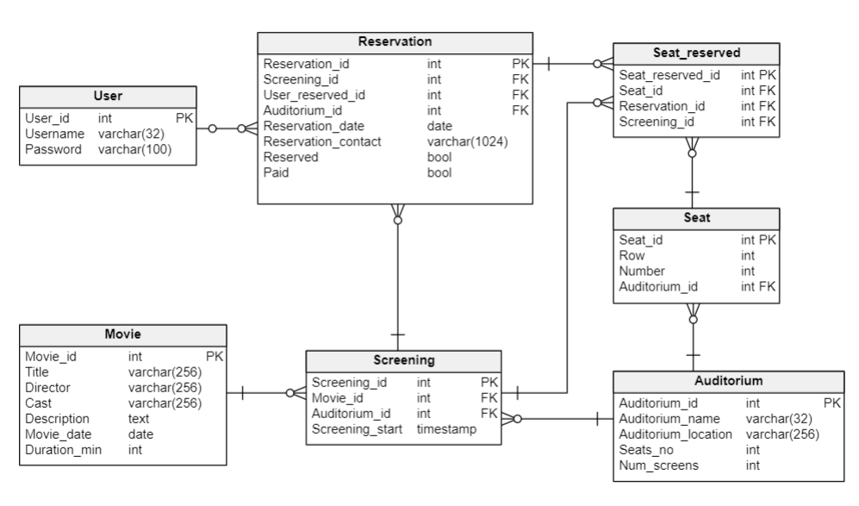
Relational Database (SQLite)
Relational database follows ACID(Atomicity, Consistent, Isolated, Durable) properties while carrying out queries despite any form of interruption like power failure, program or an operating system crash.
However, the CAP(Consistency, Availability, Partition) theorem by Eric Brewer states that “distributed systems cannot have consistency(C), availability(A), and partition(P) all at the same time”.
RDBMS allows data to be stored in rows and columns, and it ensures tables with relationships are always in sync because of Referential Integrity.

Slide 6
NoSQL Database (MongoDB)
MongoDB is schemaless, therefore collections do not need to be defined first before executing CRUD (create, retrieve, update & delete) code.
A collection can have several documents and these documents do not necessarily have the same number of keys. NoSQL databases have a lot of autonomy and can manage structured, unstructured and semi-structured data.
Many NoSQL databases implement eventual consistency.

Slide 7
Conclusion / Recommendations
Ticket cancelation service can be provided.
A table to store the payment details can be included in the current relational database design.
Include actual hotel and cab reservations in addition to merely making advice.
Wallet, vouchers, and redeemable vouchers could be added as a service.

Slide 8
Thank you

